Slide 1
Pandemic Unemployment Assistance (PUA)
Pandemic Unemployment Assistance (PUA)
Jani Revier, Director
Josh McKennna, UI Benefits Bureau Chief

Slide 2
What is PUA?
New program for unemployed workers that are not eligible for regular unemployment insurance.
Includes:
Self-employed
Part time workers
Individuals lacking sufficient work history
Those not otherwise eligible

Slide 3
Basics
Eligible for $168-448 per week
Through 7/25/20, will receive an additional $600 per week
Up to 39 weeks of benefits
Program runs from 2/2/20 to 12/26/20

Slide 4
Must be unemployed due to:
Diagnosed or experiencing symptoms of COVID 19 and seeking diagnosis.
Member of household diagnosed with COVID-19
Providing care of a family member who has been diagnosed with COVID-19
Caregiver for individual who is unable to attend school due to COVID-19
Unable to reach place of employment due to quarantine due to COVID-19

Slide 5
Must be unemployed due to: (cont.)
Unable to work due to advice of a health care provider to self quarantine due to COVID-19
Scheduled to begin but does not have a job or unable to reach the job due to COVID-19
Has become breadwinner because head of household has passed away due to COVDI-19
Quit job due to a result of COVID-19
Place of employment closed due to COVID-19

Slide 6
Not eligible
Eligible for regular unemployment insurance
Teleworkers
Receiving sick or other paid leave
Not unemployed due to COVID-19
Working full time (even if no income)

Slide 7
Steps to apply
File a claim at labor.idaho.gov/claimantportal
Will receive a letter advising that you are not monetarily eligible or monetarily pending
Do weekly certifications at labor.idaho.gov/claimantportal
Fill out self attestation
Provide proof of earnings at labor.idaho.gov/claimantportal

Slide 8
Once a claim is filed
IDOL will follow up further with you if additional information is needed. There is no need to call.
Be patient – over 48,000 claims fall into this category.

Slide 9
Step 1: File a claim at labor.Idaho.gov/claimantportal

Slide 10
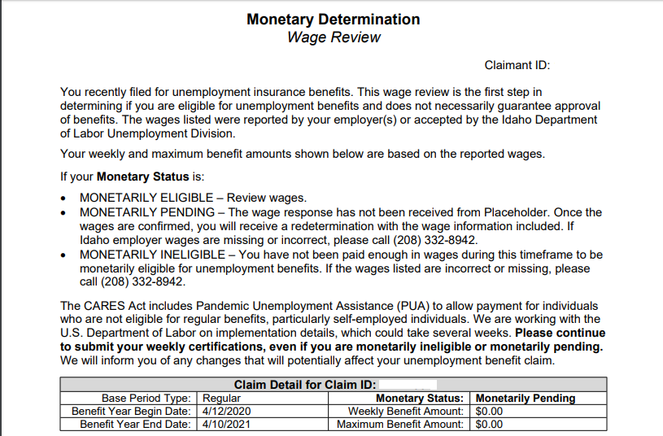
Step 2. Receive a letter explaining monetarily pending

Slide 11
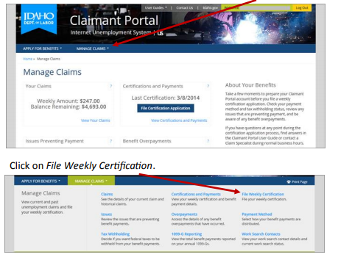
Step 3. Do weekly certification for each week you are requesting payment

Slide 12
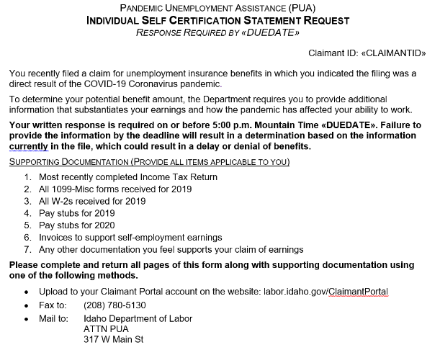
Step 4: Fill out self-attestation

Slide 13
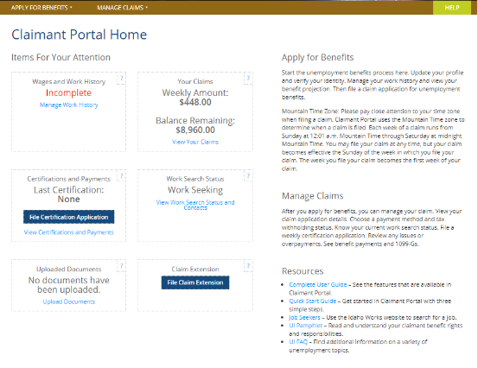
Step 5: Provide earnings information at labor.idaho.gov/claimantportal

Slide 14
Unique circumstances
I am a corporate officer, am I eligible for PUA?
My employees and I are receiving benefits under the Payroll Protection Program (PPP). Am I eligible?
PPP payments have ended, can I file a claim for benefits?
Notes:
Corporate officers are likely not eligible for UI but may be eligible for PUA.
PPP

Slide 15
Questions about your claim
View our FAQs at labor.Idaho.gov
Call us at 208 332 8942
Do a click to chat with our staff.

